Slide 2
On the cutting “Edge”: Technology skills for professional development requirements Use of EdgeUBadges at Mount St. Joseph University School of Education
OCTEO Conference
Dublin, OH
October 12, 2023

Slide 3
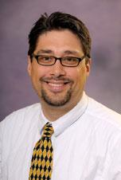

Presenters
Michael Bindis, PhD
Associate Professor
Program Director, UG & Graduate AYA & MCE
Harrison Collier, MEd
Assistant Dean of Educator Preparation

Slide 4
Terminology
Candidates
Those persons enrolled at MSJ School of Education
College-level
Students
Those persons who are enrolled in preschool, primary, elementary, middle, junior high, or high schools
Pre-Kindergarten – Grade 12

Slide 5
Goals of this session
Understand the EdgeUBadges program
What candidates and faculty think about the platform
How candidates and faculty used the platform in their learning and teaching
How the platform is utilized as professional development for candidates

Slide 6

Mount St. Joseph University
4-yr. Private, Catholic, Sisters of Charity
Cincinnati, OH - west side (Delhi Twp.)
2,027 enrolled
1,281 female
746 male

Slide 7

School of Education
1 of 5 Schools within the University
28 Faculty members
440 candidates enrolled
59 completers ‘21-’22
48 completers ’22-’23

Slide 8
Dire Conditions
Pandemic conditions beginning spring 2020
Abrupt disruption of instruction
COVID isolation fall 2020 through spring 2021
Health emergency continued 2021-2023 with in-person sessions, mask mandates, and necessary quarantining

Slide 9
Instruction
How do we reach candidates?
How can practicum & student teacher candidates reach their students?
Can effective instruction continue?
If so, how?

Slide 10

EdgeUBadges
What is it?
A professional online learning system designed for teachers

Slide 11
EdgeUBadges
How does it work?
Participants earn “badges” as a form of microcredentialing for various productivity or teaching tools. Badges are worth points. 1 pt = 15 mins

Slide 12
EdgeUBadges
What are its features?
Badges are curated by topic, thus the user can be guided to use a variety of badges to master the topic.
Example of topics:
Student-Centered Learning
Social-Emotional Learning
Diverse Learners
Feedback & Assessment
Collaboration Tools
AI Training

Slide 13
EdgeUBadges
What did we ask faculty to do?
Use the system for their own learning and develop or improve their tech skills
Incorporate the use of Badges in their teaching as a way to engage candidates in their learning

Slide 14
EdgeUBadges
What did we ask candidates to do?
Use the system for their own learning and develop or improve upon their technology skills
Incorporate what they learned from the use of Badges in their lessons taught to students to heighten engagement

Slide 15
Professional Development
How EdgeUBadges’ use evolved in School of Education
Used as a way to increase use of tech in candidates’ lessons
Used as a way to engage our candidates during the pandemic
Used as way for our candidates to engage their students during the pandemic and beyond
Used a way to complete conference requirements as conferences were virtual and could be cost-prohibitive

Slide 16
Inquiry
To what extent was the system used in our programs for our faculty, candidates, and students?
In what ways was the system used in our programs?
What benefits or drawbacks did users see with the system?

Slide 17
Methodology
Examined overall use data provided by EdgeUBadges
Used a survey for faculty and candidates with 5-pt. Likert scale and open-ended questions
All responses done anonymously
Asked students about their rank and licensure
Asked faculty to specify in which licensure area they mainly worked

Slide 18
EdgeUBadges Use: Statistics 7/2020 – 9/2023
Cumulative total points | 985
Total professional learning hours | 246.25
Estimated classroom impact hours | 492.5
Selected time period total badges | 426
Selected time period active users | 56

Slide 19
EdgeUBadges Use: Top 10 Badges at MSJ
Adobe Spark: Page
Book Creator Brilliant
Cybersecurity: Social Engineering
SEL Skills: Build Relationships with Your Students
SEL Skills: Empathy and Kindness in the Classroom
Google Drive Sharing Superstar
Screenshot Specialist
Incognito Anonymous
Gmail Genius
Google Calendar Clever

Slide 20
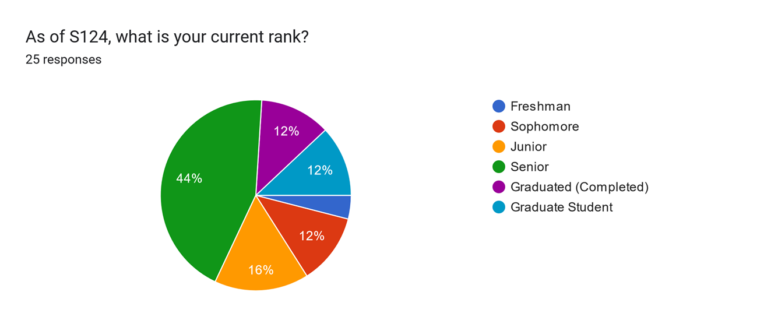
Survey results: candidates

Slide 21
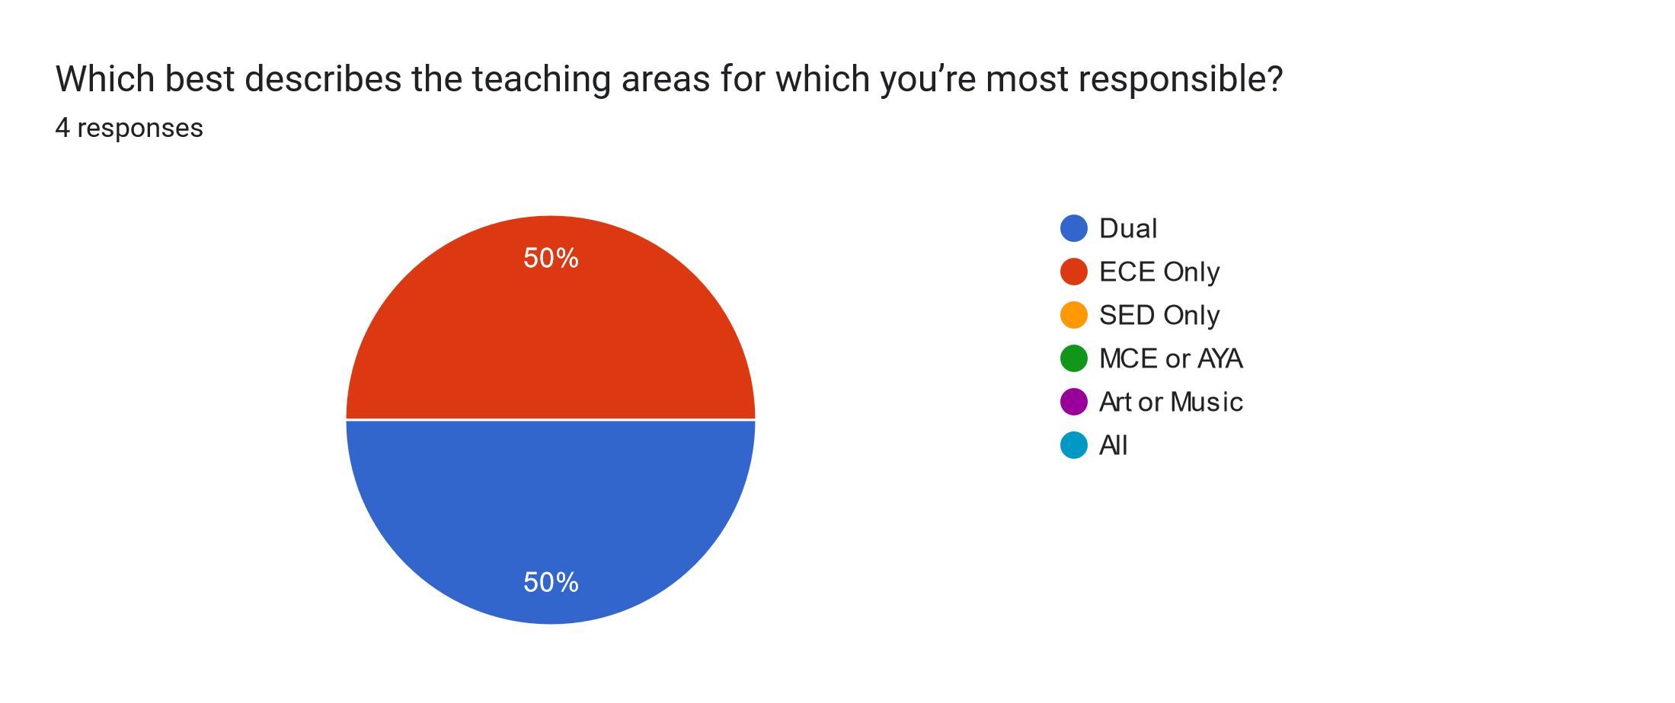
Survey Results: Faculty

Slide 22
EdgeUBadges: Extent of Use

Slide 23
EdgeUBadges: Features

Slide 24
EdgeUBadges: Future Use

Slide 25
EdgeUBadges Use: MSJ Candidates Survey
“Learning more about google and different technological games and applications have been useful.”
“I have the google skill which helps for teaching the students as well as other teachers!!”
“I have used the skills by implementing strategies I learned from using different websites and using them in my lesson plans.”
“I have become more advanced in my placement that has MacBooks. I became an Apple Certified teacher with Edge U and it has helped tremendously.”

Slide 26
EdgeUBadges Use: MSJ Candidates Survey
“I used them to meet class requirements, but they were not worth my time.”
“So far, I must confess I haven't been utilizing EdgeU anywhere near as much as I should. I've been starting to get lost in the requirements for getting and then maintaining a license.”
“I have no idea what EdgeUBadge is nor as any class required it's use in their class.”

Slide 27
EdgeUBadges Use: General Themes
From MSJ Candidates Survey
Mixed results: some students are aware of program, others are not
“I just don't feel that they're integrated into classes well. There's no real encouragement just a random mention every so often about them.”

Slide 28
EdgeUBadges Use: General Themes
From MSJ Candidates Survey
“They give me more opportunities to implement technology in my lesson. EdgeU also helps me be familiar with all of the technological tools we use in the classroom today.”

Slide 29
EdgeUBadges Use: General Themes From MSJ Candidates Survey
“They have had no impact on my teaching rather a boring review of foundational skills.”
“None” or “No impact”
“N/A”

Slide 30
EdgeUBadges Use: MSJ Faculty Survey
“I used EdgeUBadge during the remote Covid year to learn new technologies for remote instruction. I haven't used it much at all since then.”
“I have used EdgeUBadge to learn or improve upon my technology knowledge and consider other ways I could teach or provide student engagement options.”

Slide 31
EdgeUBadges Use: MSJ Faculty Survey
“I've included JamBoard, Hyperdocs, Flipgrid and EdPuzzle as part of my classes on Zoom, and use Google all the time with my face to face classes. I include comments for some assignments to students using screencast and loom, where I can post the link on Blackboard for them to access.”
Faculty were very positive about EdgeUBadges

Slide 32
EdgeUBadges Use: General Themes
From MSJ Faculty Survey
“Learning new tech skills impacted the engagement of my students during covid as all classes were online only. The success of the tech has allowed me to continue to build it successfully into my classes, and support my students, all of whom are Education majors, with building this in their lesson planning for class assignments and practicums.”

Slide 33
Next Steps
Thorough audit of where EdgeUBadge is being used in our programs
Improve communication about program, earlier in program

Slide 34
Next Steps
Incorporate the system more throughout teacher preparation program
Advertise that it can be used for professional development for candidates to satisfy conference requirement
At least one student appreciated EdgeUBadges as alternative for conference requirement
Currently, 46 students have used EdgeUBadge for this purpose

Slide 35
Requirements & Standards
OSTP: Technology in Instruction
“Teachers use resources effectively, including technology, to enhance student learning.”
OTES 2.0: Focus for Learning
“The teacher’s instructional plan incorporates activities, assessments and resources, including available technology, that align with student needs, school and district priorities, and Ohio’s Learning Standards.“

Slide 36
Requirements & Standards
CAEP Standards 2022
R1.3 Instructional Practice: “Providers ensure candidates model and apply national or state approved technology standards to engage and improve learning for all students.”
R3.2 Monitoring & Supporting Candidate Progression: “The provider creates and monitors transition points from admission through completion that indicate….the ability to integrate technology effectively in their practice.”
R3.3 Competency at Completion: “The provider ensures candidates possess academic competency to teach effectively….through application of….technology integration in the field(s) where certification is sought.”
R6.3 Faculty Resources: “The EPP provides adequate resources and opportunities for professional development of faculty, including training in the use of technology.”

Slide 37
Requirements & Standards
ISTE: Seal of Alignment 2022-2024 Educator Standards
Aligned with at both foundational and applied levels
EdgeUBadges is aligned to ISTE Standards

Slide 38
Conclusion
Re-assess yearly the use of EdgeUBadges in the School of Education
If we continue to use, make sure that its use is well-grounded in coursework across programs
Introduce its use in the earliest classes
Make sure its use is authentic in courses and clinical placements

Slide 39
Recommendations for Future Use
Faculty use in preparing teacher candidates
Candidate use in lessons for benefit of engaging students in learning and exposing mentors to technology, list on resumes
Use as continued professional development for graduated candidates as teachers, include in IPDPs for contact hours
Use by districts for professional development for furthering technology skills of teachers

Slide 40
Questions?
Michael Bindis
michael.bindis@msj.edu
Harrison Collier
harrison.collier@msj.edu

